Slide 1

2021 STEM BOP
2021 STEM BOP
Tony Li, Saikarthik Mummadisingu , Justin Wong, Elizabeth Lin, Breanna Tesorio, Dylan Patel, Yashraj Bhandare
The Voiceless
Notes:
Justin
Hey everyone, my team will now be presenting our findings on the BOP. We are Team 3, and our team name is The Voiceless. We can’t wait to share with you guys with our discoveries.

Slide 2
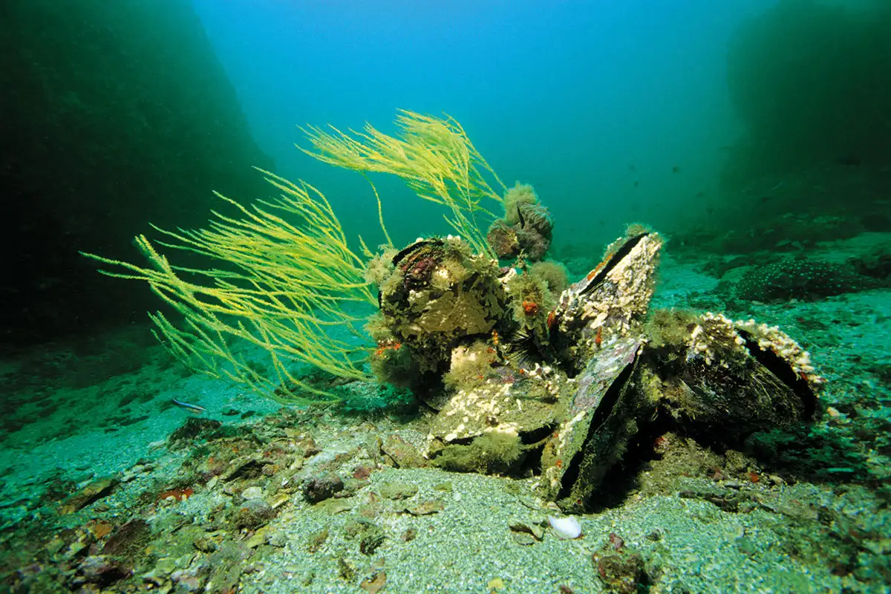
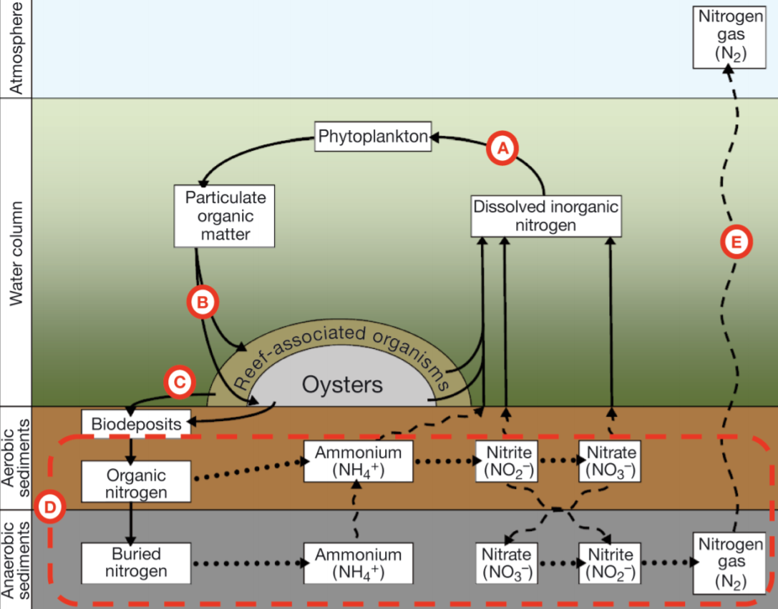
What are oysters? What do they do?
Oysters are nonmobile, bivalve mollusks
3 Essential Functions
Biodiversity
Filters water
Denitrification
Sources: https://www.sarasota.wateratlas.usf.edu/upload/documents/Denitrification-and-Nutrient-Assimilation-on-a-Restored-Oyster-Reef-4-22-13.pdf
https://www.billionoysterproject.org/ecosystem-engineers
Notes:
Global loss of oysters in the past century has led to greater recognition of their roles in maintaining healthy marine habitats. So, what are oysters, and what do they do?
Oysters are nonmobile, bivalve mollusks, meaning that they permanently stay in one place and have a hinged shell enclosing their bodies. However, though they don’t move, they service their marine ecosystem to a great extent, increasing biodiversity by creating oyster reefs, filtering up to 50 gallons of water a day by eating biological sediment around them and excreting them in pseudofeces, and allowing denitrifying microbes and other extremely important organisms to thrive.

Slide 3

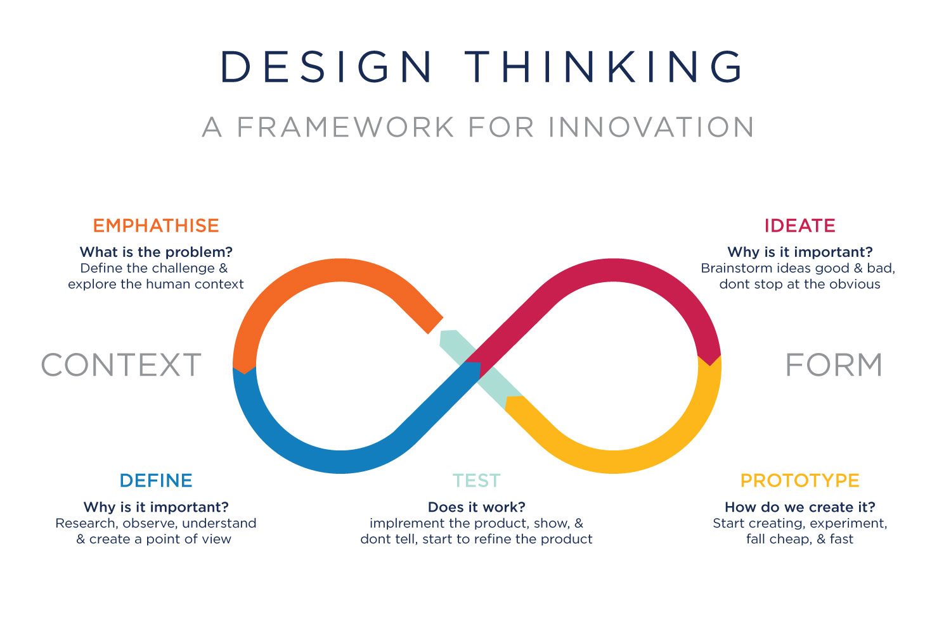
Design Thinking
Data Visualization
Notes:
Justin
So, the first and foremost step in creating a research question related to the BOP, of course,is to understand what oysters are and do, which Tony previously explained. Afterwards, in order to further research on oysters and their capabilities, our team decided to utilize Design Thinking and Data Visualization as both a format in creating our question, and to portray our results in an understandable manner. Here’s a superficial overview of what the process of Design Thinking is like, and from gathering the different perspectives from our group, jumping ideas around in order to define and empathize the problem, it eventually led to our research question of:

Slide 4
How does an oyster’s shell size and habitat temperature affect its ability to filter water?
Notes:
Justin
. . . which is what our presentation will revolve around.

Slide 5
Sites for our Data
Bush Terminal Park
Lemon Creek Nursery
Great Kills Harbor
We will be creating separate graphs and analysis for each individual site to avoid confounding variables (time, latitude & longitude, salinity, conductivity, pH, TDS, dissolved oxygen).
Notes:
Dylan Patel
To answer our research question, we used data from bush terminal park, lemon creek nursery, and great kills harbor. We will also be creating separate graphs and analysis for each individual site to avoid confounding variables. Some of these variables include time, salinity, and conductivity.

Slide 6



Python Libraries Utilized:
matplotlib
scikit-learn
numpy
Notes:
Sai
Here is the python libraries that were utilized in writing our code
We used matplotlib for graphing our data
Scikit learn for linear reg
And numpy for the arrays

Slide 7
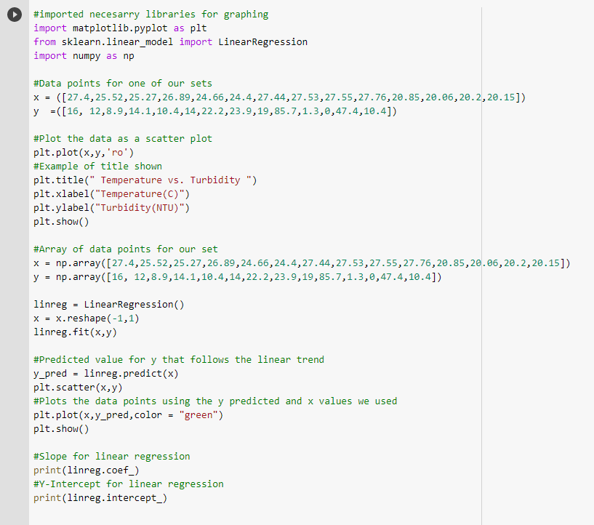
Notes:
Sai
Here is the general code we used to make all of our graphs
We imported our libraries and inputted our data points(These are the data points for bush terminal park)
Then we plotted a scatter plot
After that we coded the x and y arrays containing the same data points
Then we performed linear regression and plotted a line

Slide 8
Oyster Shell Size
Vs.
Rate of Filtration
Oyster Shell Size
Vs.
Rate of Filtration
Oyster Shell Size measured via Calipers
Rate of Filtration indicated by Turbidity
Notes:
Breanna
Explain units -- me

Slide 9
Hypothesis: The longer an oyster’s shell height, the lower the turbidity of the water, as a greater shell height is indicative of a more mature oyster, which are able to filter more water.
Notes:
Breanna

Slide 10
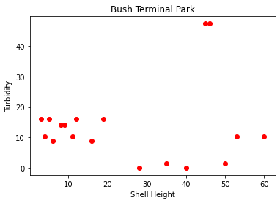
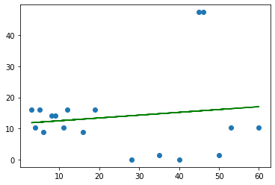
Notes:
Dylan Patel : For bush terminal park, there’s a weak positive correlation between the turbidity and the shell height. Even so, The graph rejects our hypothesis. What we were expecting was a negative trend and what we got was a positive trend.

Slide 11
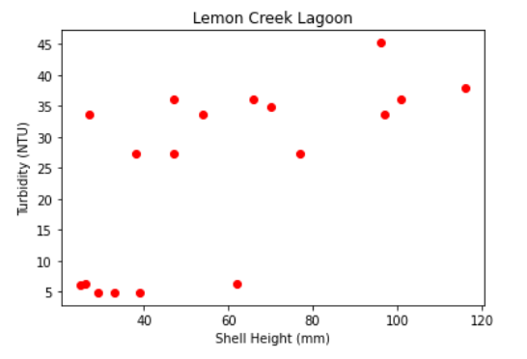
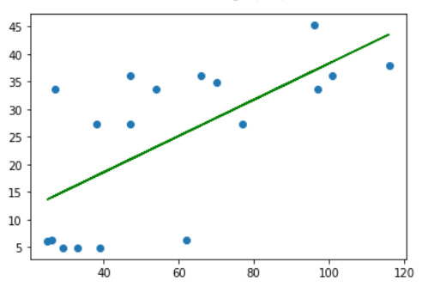
Notes:
Elizabeth
Rejects 1st hypothesis

Slide 12
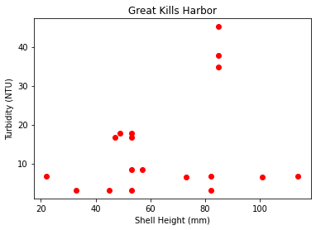
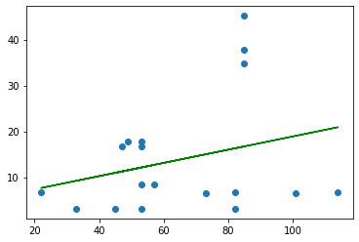
Notes:
The data collected for Great Kills Harbor completely rejects our first hypothesis, as the line of best fit has very poor correlation with the data points and has a low r^2 value. For example, the small jump from approximately 82mm to 84mm in shell height produces a massive jump in turbidity, but then dips down again at 100mm, showing that shell height has little effect, if any, on turbidity.

Slide 13
Habitat Temperature
Vs.
Rate of Filtration
Habitat Temperature
Vs.
Rate of Filtration
Habitat Temperature measured via loggers
Rate of Filtration indicated by Turbidity
Notes:
Elizabeth

Slide 14
Hypothesis: When an oyster’s habitat’s temperature increases, the turbidity of the water will decrease, as the oysters will possess a higher metabolism, until non-optimal conditions prove detrimental.
Notes:
Elizabeth

Slide 15
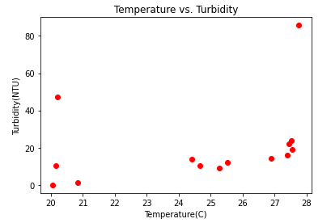
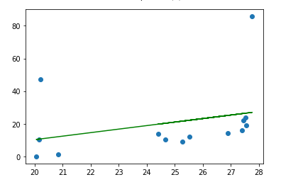
Bush Terminal Park
Notes:
Sai M
This is our graph for the Bush terminal park where we compared temperature and turbidity
When we performed linear regression there is a weak positive correlation which rejects our hypothesis since the graph show that the turbidity increases as temp increases

Slide 16
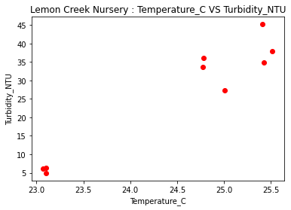
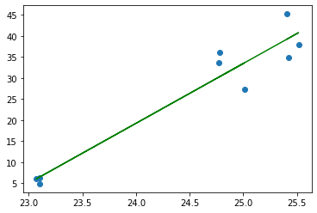
Notes:
Breanna

Slide 17
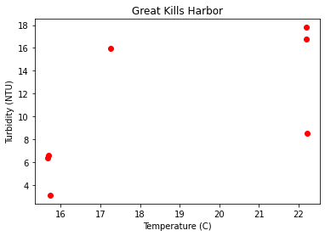
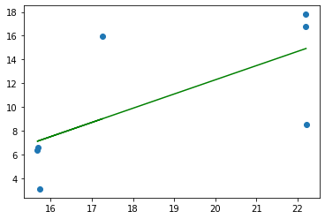
Notes:
The graph shown here also rejects our second hypothesis, since the general trend associated with the line of best fit is that as temperature increases, turbidity also increases, or in other words, they are proportional, whereas our hypothesis guessed at an inversely proportional relationship. However, since there are so few data points, the results could be inconclusive.

Slide 18
Conclusions & Analysis
Bush Terminal Park, Eastern Lagoon | 40.65389 | -74.01879 | Maximum of 631,000 oysters at this site | 631000 | Total of ten oyster cabinets; Two bagged shell plots with a total of 192 mesh bags and 91,000 oysters
Bush Terminal Park, Western Lagoon | 40.65453 | -74.01978 | Maximum of 91,000 oysters at this site | 91000 | Two bagged shell plots with a total of 192 mesh bags and 91,000 oysters
Lemon Creek Nursery | 40.5129 | -74.19932 | Maximum of 30,000 single set seed oysters or 3,000 adults at this site | 33000 | Total of four OysterGro cages (6 bags per cage); Total of 3 Seapa 600 Premium cages
Great Kills Harbor Nursery | 40.54352 | -74.13946 | Maximum of 132,000 spat-on-shell or 13,200 adult oysters at this site | 145200 | Total of 60 trays (20 stacks of 3 each)
Notes:
Breanna - So what exactly do the graphs we just presented tell us. First off, before completely analyzing or making conclusions based off of our results, I just wanted to again emphasize that our results and data may have been swayed by any external variables we weren’t aware of. This is some of the data gathered from the Oyster Reefs in NY, and as you can see, one vivid external variable is, not only the number of oysters present, but also the stage in the oysters’ development. Perhaps the mere presence or size of oyster reefs affects turbidity. Perhaps, the manner in which they placed oysters into the bodies of water affected turbidity, or spats, which are young oyster larvae that finally attached onto a shell, attached to a large piece of calcium carbonate shell. Rain could have also played a role. This is why, again, we collected data from separate sites to minimize these confounding variables.
Elizabeth - Focusing on the graphs investigating a relationship between shell height and temperature, we found that as shell height increases, the turbidity increases, which rejects our hypothesis, as we expected that larger shells meant more mature oysters, so the water would be cleaner and clearer. However, our graphs show that the water gets dirtier as oyster shells are larger. For the graphs that analyzed temperature and turbidity, all graphs showed a trend that as temperature increases, the turbidity also increases. This means that as temperatures increase, the water actually gets dirtier, indicating that hotter temperatures may inhibit an oyster’s ability to filter water. This also rejects our hypothesis.

Slide 19

Thank you for listening!
Why does this question matter?
Notes:
So why does this question matter? I’m asking myself this because, sometimes you see presentations on a certain topic, but it doesn’t really matter because it doesn’t affect or impact anything. For example, if we were to gather data on “Do more people like the color blue?”, that information is honestly useless, like who’s going to use that data.. But, undoubtedly, our information “matters” because these findings can aid in achieving the goal of 1 billion oysters in the BOP. For example, BOP volunteers may not have to stress over gathering large shells for oysters, as they may not actually impact an oysters’ ability to filter water at all. What I want to focus more, however, is our discovery of a negative correlation between temperature and turbidity; especially in relation to global warming. As you all know, Global warming is a phenomenon detrimental to ecosystems, the earth’s temperature, and organisms’ survivability, while furthering natural disasters. As the oceans or bodies of water get warmer, the increase in temperature may by gradually inhibiting an oyster reef’s ability to filter water. So, we have to remain cognizant of the devastating effects global warming has on organisms in general, and oysters.

